Slide 1
Autonomous car

Slide 2

Table of contents:
1
2
Hardware
Simulation
3
Peripherals

Slide 3
1.Hardware

Slide 4
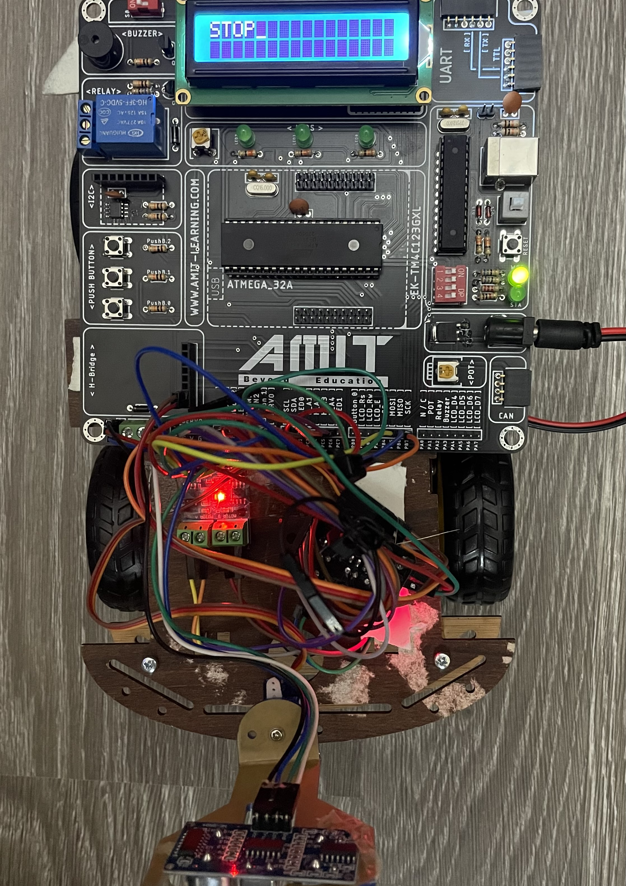
4 DC motors
L293D H-bridge
L9100 H-bridge
Servo motor
LCD
Ultra sonic sensor

Slide 5
2.Simulation

Slide 6
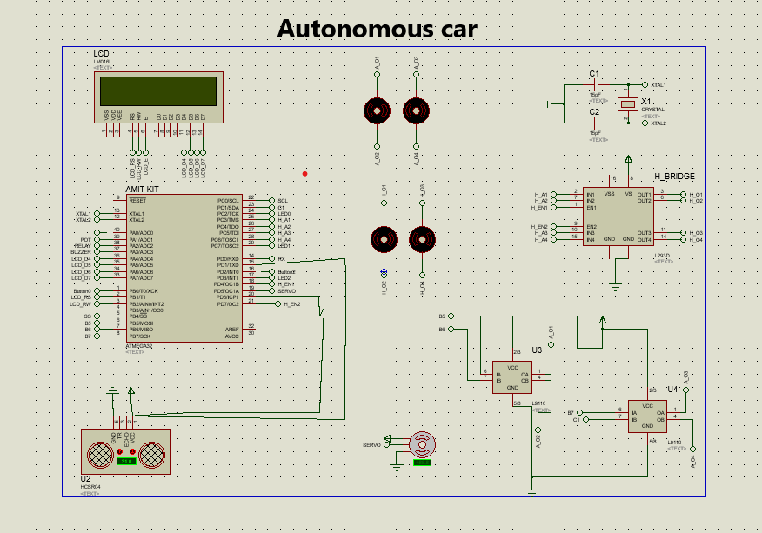

Slide 7
3. Peripherals

Slide 8
Libraries:
Standard types
Bit math
DIO
TIMER1

